Slide 1
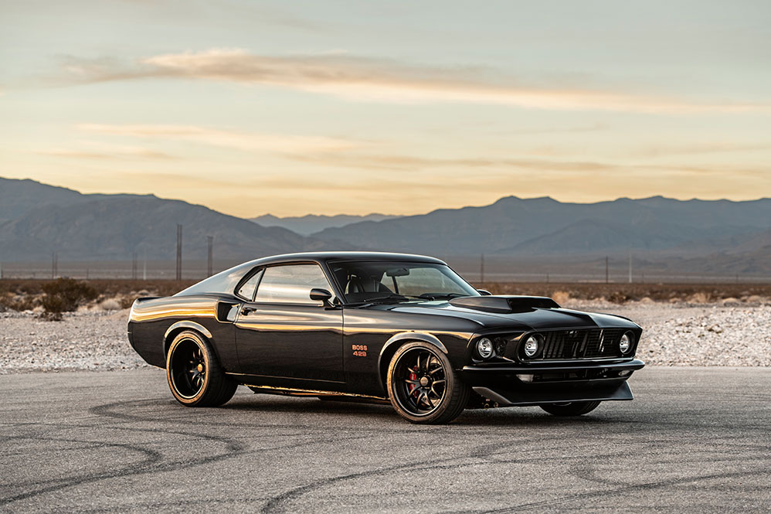

Cars Dataset Clustering and Regression Analysis with R a BANA 200 – Foundations in Business Analytics
Mike Adhitya Williams (54209437)

Slide 2



1|
Goals and Objectives

Slide 3
Goals and objectives
Steps
Goals and Objectives
Importing the Data File into R
Analysing the average gas consumption for different types of cars
Data Cleansing
New Independent Variables
Cluster Analysis
Regression Analysis
Determining the relationship between the engine power, gas consumption, and cluster group using data visualization
1
Dependent variable
Avg.mpg (Average miles per gallon)
Discovering the dependent variable, average gas consumption and independent variables, engine power and size (volume) through regression analysis of each clustering group
2
Independent variables
Horsepower (Engine power)
Volume (A volume of a specific car)

Slide 4
2|
Importing the Data File into R

Slide 5
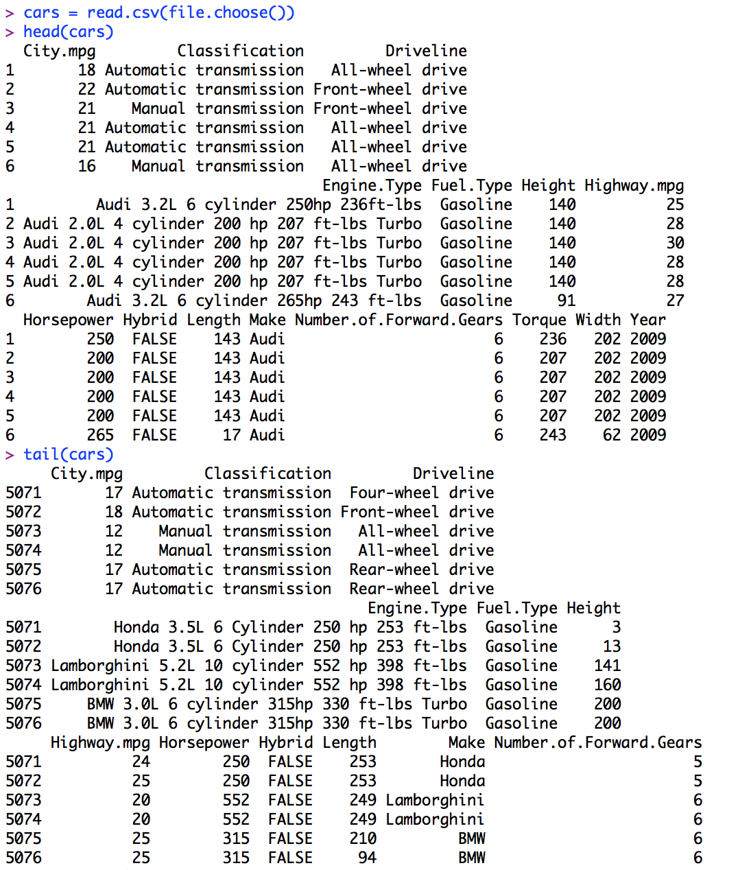
Importing the data file into R
1
2
Making sure the dataset file is converted to a comma separated value file (.csv)
Write the code labelled “1” to import the dataset file into R
cars = read.csv(file.choose())
2
Check if the code is correctly imported with the code labelled “2”
head(cars) and tail(cars)

Slide 6
3|
Data Cleansing

Slide 7
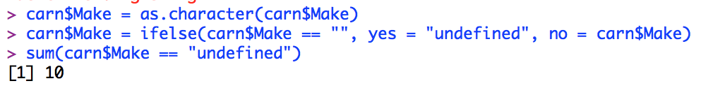
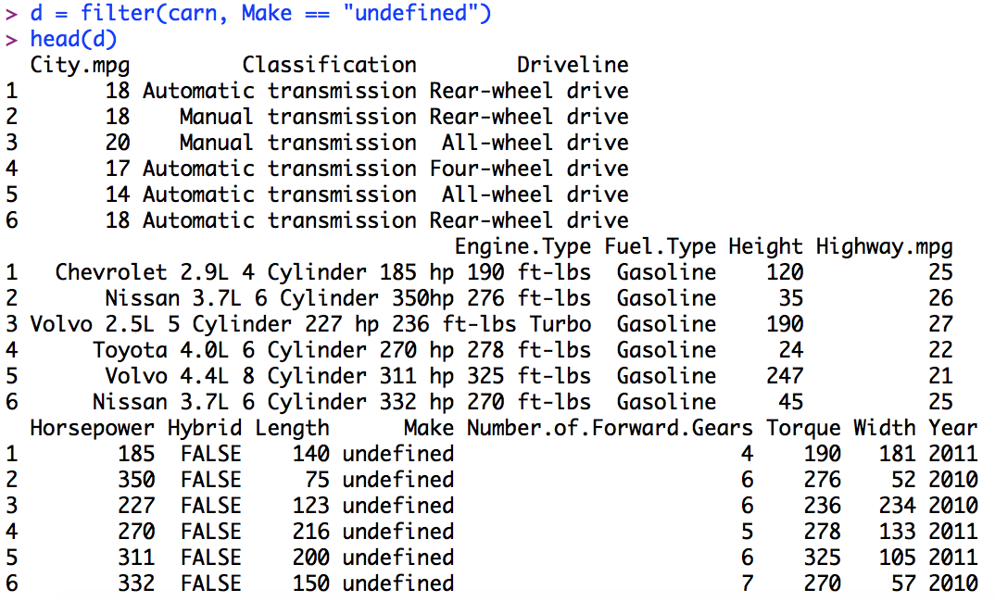
Data cleansing
Observations
In the initial dataset, there are several observations on the variable “Make” which are missing or blank
Therefore, we wanted to eliminate those missing values
Due to the fact that the variable Make is a categorical variable, we will replace the missing values with the value “undefined”
Coding involved
> carn$Make = ifelse(carn$Make == “”, yes = “undefined”, no = carn$Make)
> sum(carn$Make == “undefined”)
> d = filter(carn, Make == “undefined”)

Slide 8
4|
New Independent Variable

Slide 9
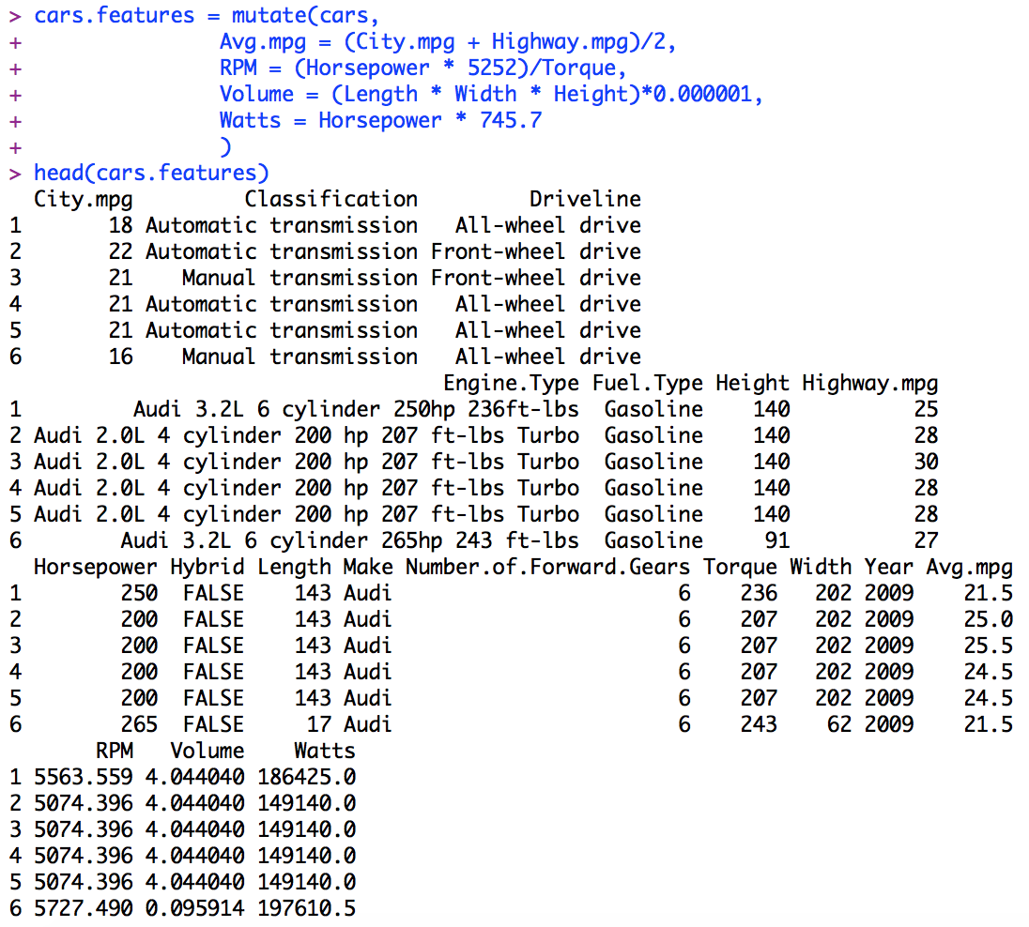
New independent variable
New Variables
Codes Involved:
cars.features = mutate(cars, …)
New dependent variable
Average miles per gallon
Avg mpg = (City mpg + Highway mpg) / 2
New independent variable
RPM (Rotations Per Minute)
RPM = (Horsepower x 5252) / Torque
Volume
Volume = (Length x Width x Height) x 0.000001
Watts (Power)
Watts = Horsepower x 745.7

Slide 10
5|
Cluster Analysis

Slide 11
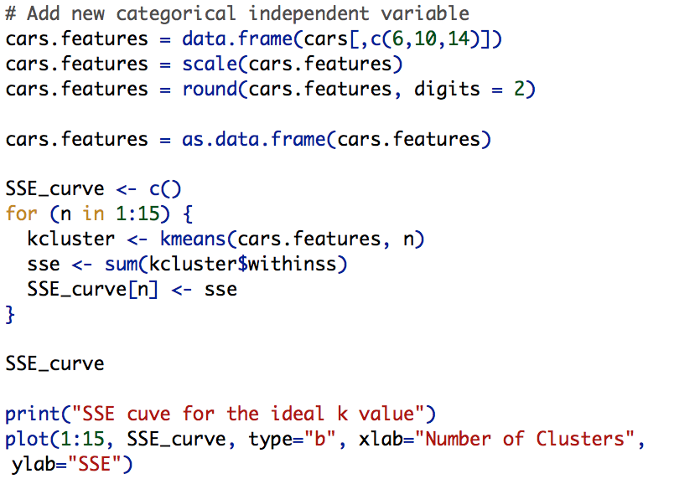
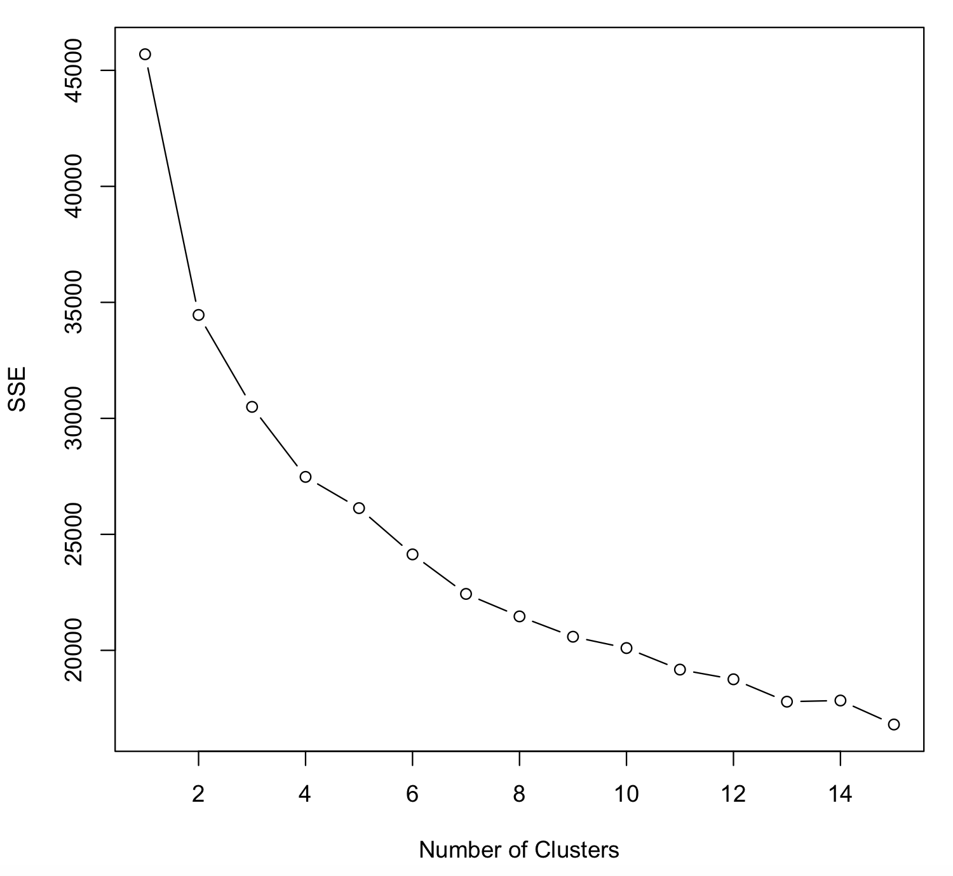
Kmeans and new categorical independent variable
cars.features is a variable to store a dataframe containing the values Height, Length and Width, which will be the variables to construct new categorical independent variable “cluster”
In order to check the suitable number of clusters, the series of code above will shows a SSE curve to determine the ideal k value

Slide 12
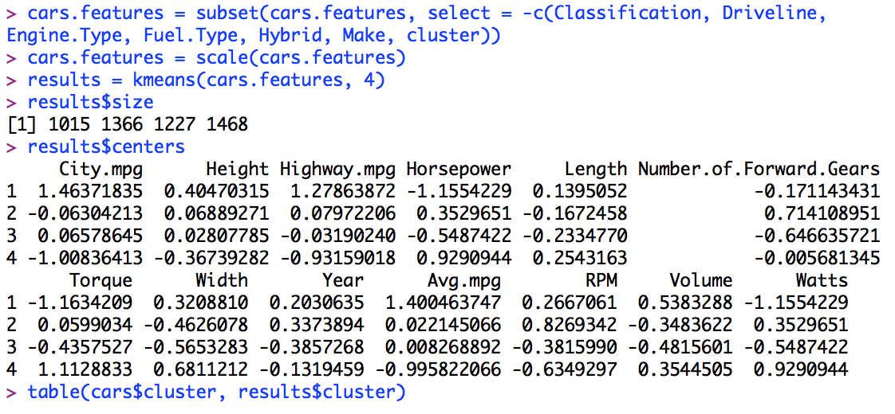
Cluster Analysis
Coding Involved
Steps breakdown
1
To ease clustering analysis, we have to dropped down all of the categorical variable
1
2
If the values across the dataset have a considerably huge amount of difference, we can firstly standardize them to make the observation better and clearer for the audiences
3
2
4
Applying kmeans() function and identifying the number of clusters (k) will start the clustering process
3
4
To observe the element of the clustered variable:
results$size: this command will tells us the number of observations in each cluster
results$centers: this command will tells us the median value from all variable in each cluster
results$cluster: this command will shows the detailed clustering mapping of all the observations in the dataframe

Slide 13
6|
Data Visualization with R

Slide 14
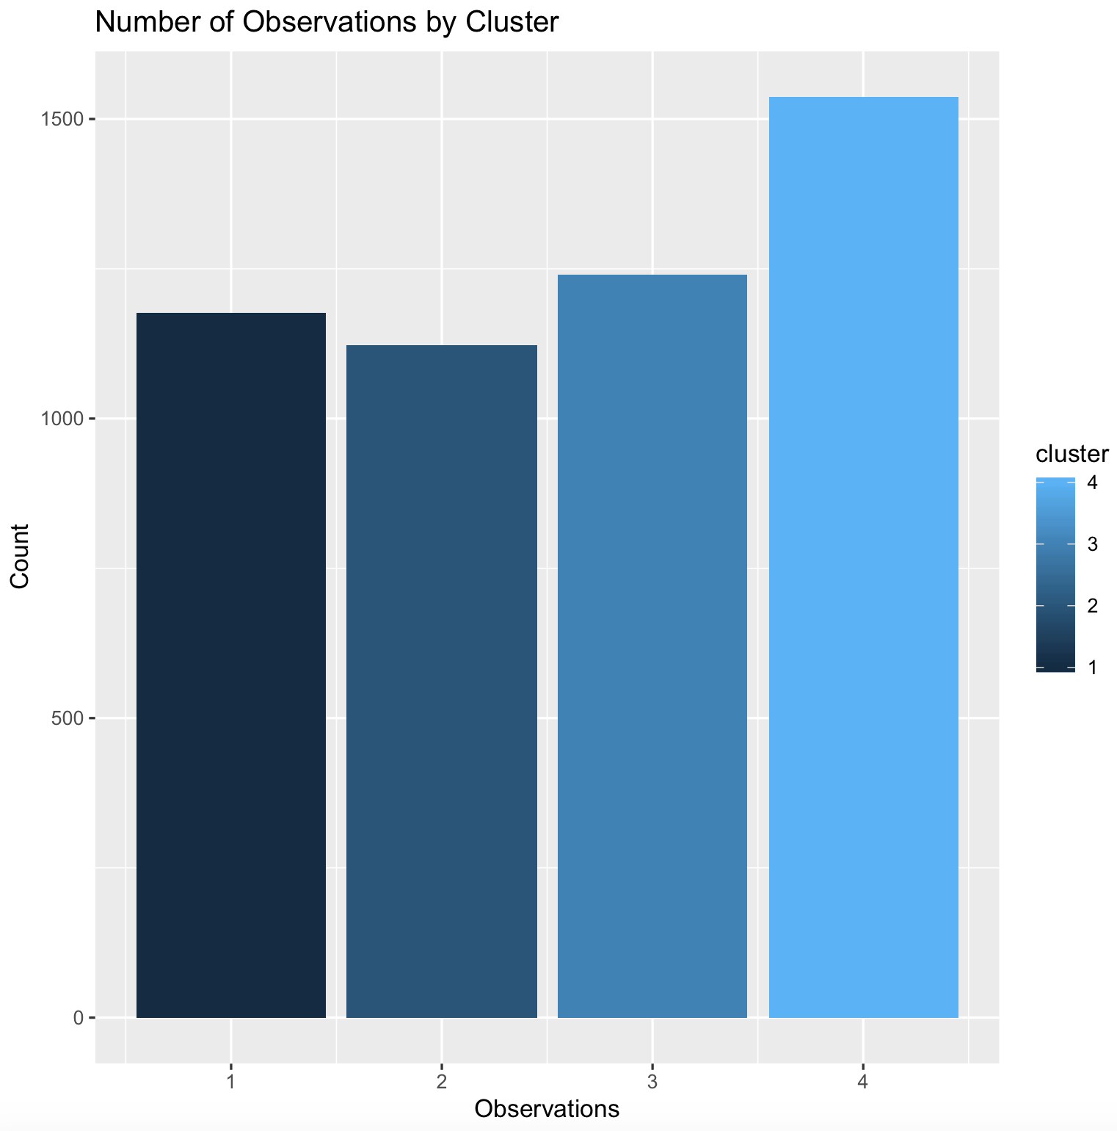
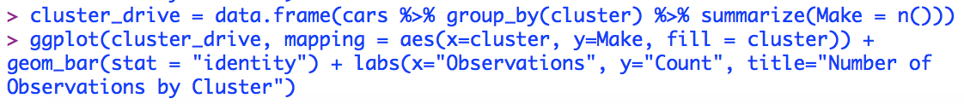
Barplot
Coding involved
> cluster_drive = data.frame(cars %>% group_by(cluster) %>% summarize(Make = n()))
> ggplot(cluster_drive, mapping = aes(x=cluster, y=Make, fill = cluster)) + geom_bar(stat = "identity") + labs(x="Observations", y="Count", title="Number of Observations by Cluster")
Observations
To start with, by applying a simple barplot with ggplot, we can immediately informed about the distribution of the observations mapped to the respective cluster groups
Cluster 4 has slightly the biggest amount of observations compared to the other 3 cluster

Slide 15
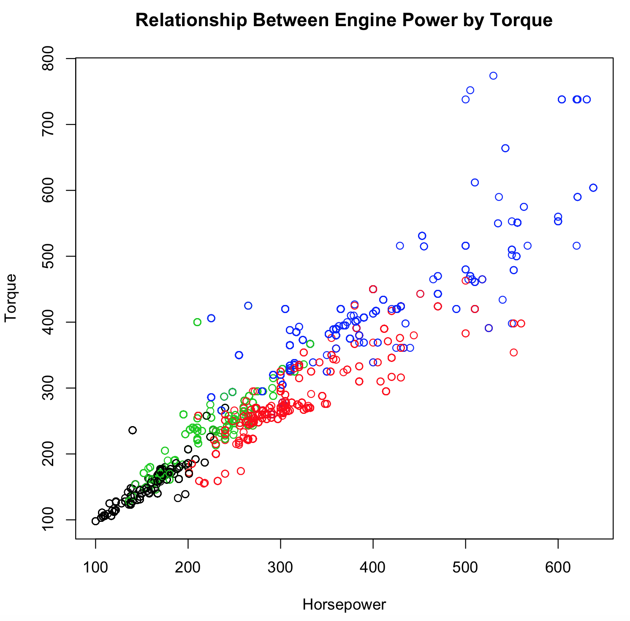
Scatterplot
Coding involved
> plot(cars[c(“Horsepower”, “Torque”)], main = “Relationship Between Engine Power by Torque”, col = results$cluster)
Observations
From the scatterplot graph, it can be seen that there is a linear relationship between the amount of engine power (Horsepower) with Torque
The bigger the engine power a car has, the bigger the torque generated

Slide 16
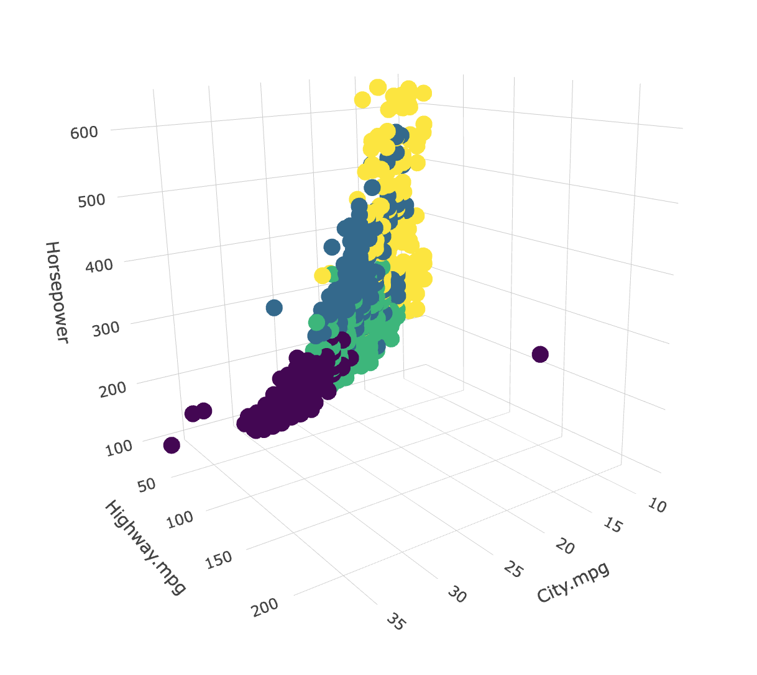

3D Plot
Coding involved
> install.packages(”plotly”)
> library(plotly)
> plot_ly(cars, x=~City.mpg, y=~Highway.mpg, z= ~Horsepower, color=results$cluster)
Observations
The gas consumption on highway driving is relatively the constant or the same despite the different amount of engine power
The car with the higher engine power (Horsepower) are less efficient to drive around in the city in terms of its gas consumption

Slide 17
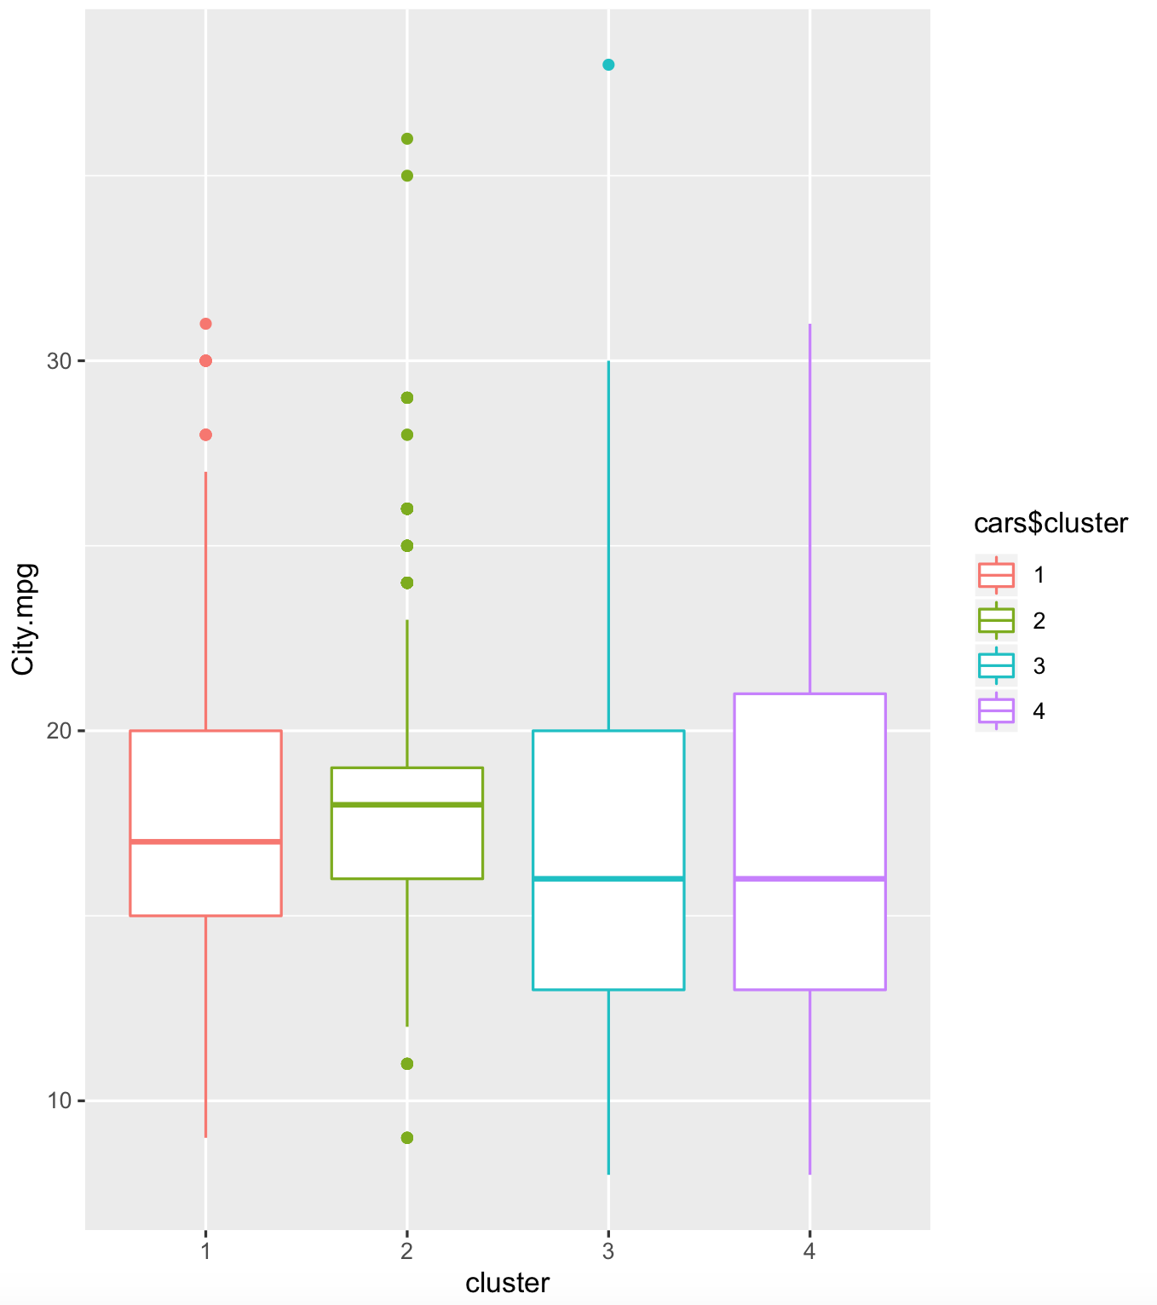
Boxplot
Coding involved
> install.packages(”ggplot2”)
> library(ggplot2)
> cars$cluster = as.factor(cars$cluster)
> ggplot(cars, mapping=aes(x=cluster, y=City.mpg, color= cars$cluster)) + geom_boxplot()
Observations
Following the previous data visualization, the boxplot are used to allows us to perform further observations in gas consumption when driving around the city
The City.mpg variable are plotted respective to the cluster group, thus, some outliers can immediately be identified from the graph, which marked as points outside either the upper or lower whisker

Slide 18
7|
Data Frames using the Categorical Variable “cluster”

Slide 19
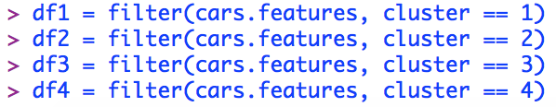
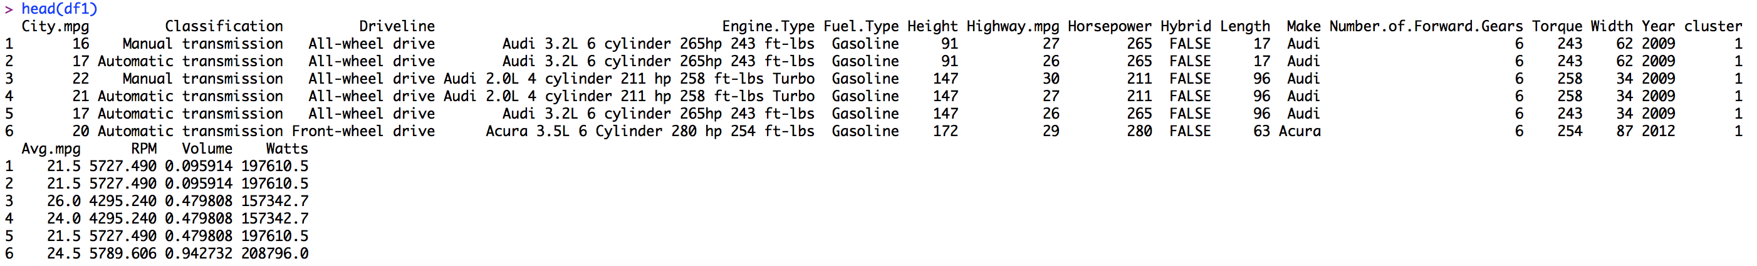
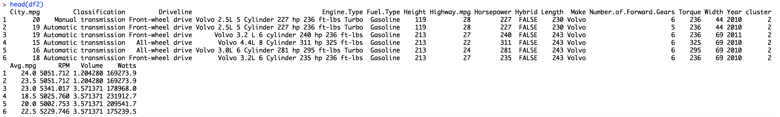
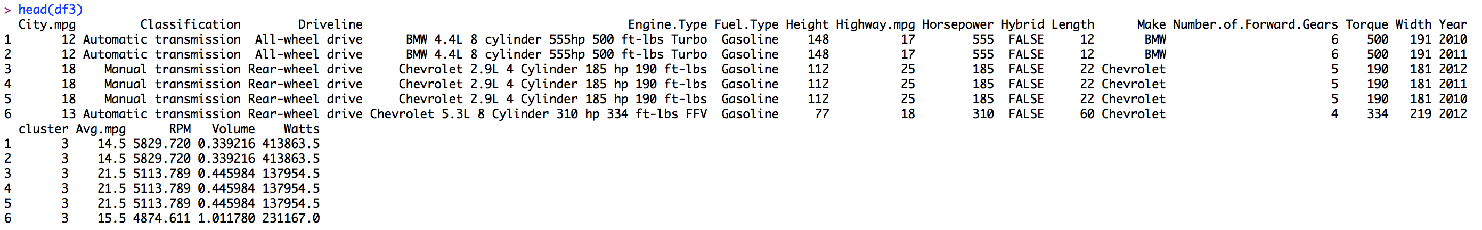
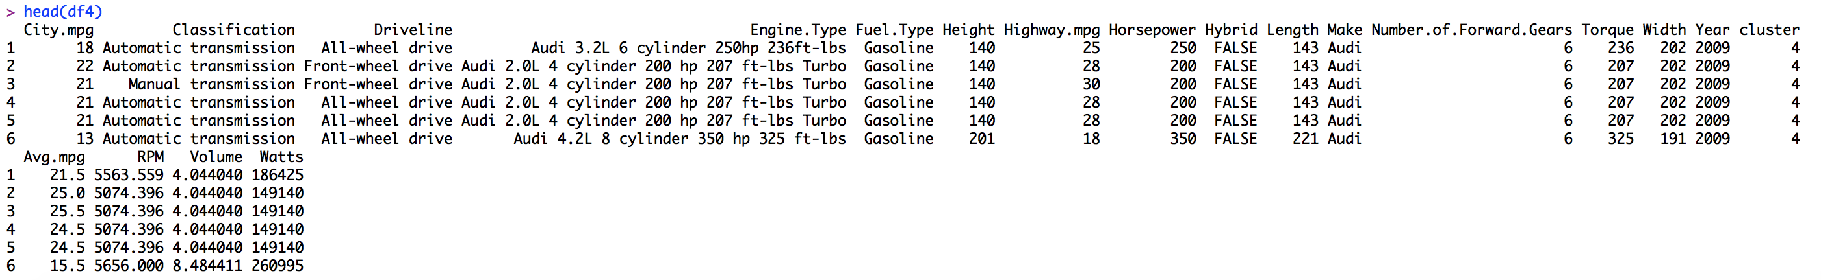
Data frames corresponding to categorical variable “cluster”
1
Steps
2
1
By applying the filter() function, we can easily filter the observations that only we wanted. In this case, we separate the data cars.features into 4 different data frames. Each data frame have the same value for the variable cluster
2
2
After assigning each respective data frames into unique variables (df1, df2 , df3, df4), we can then try to check if the data frame is exactly as we wanted. head(df#) should do the job.
The red dotted line indicates that the data frame only consists of the observation from the respective cluster group
2
2

Slide 20
8|
Regression Analysis

Slide 21
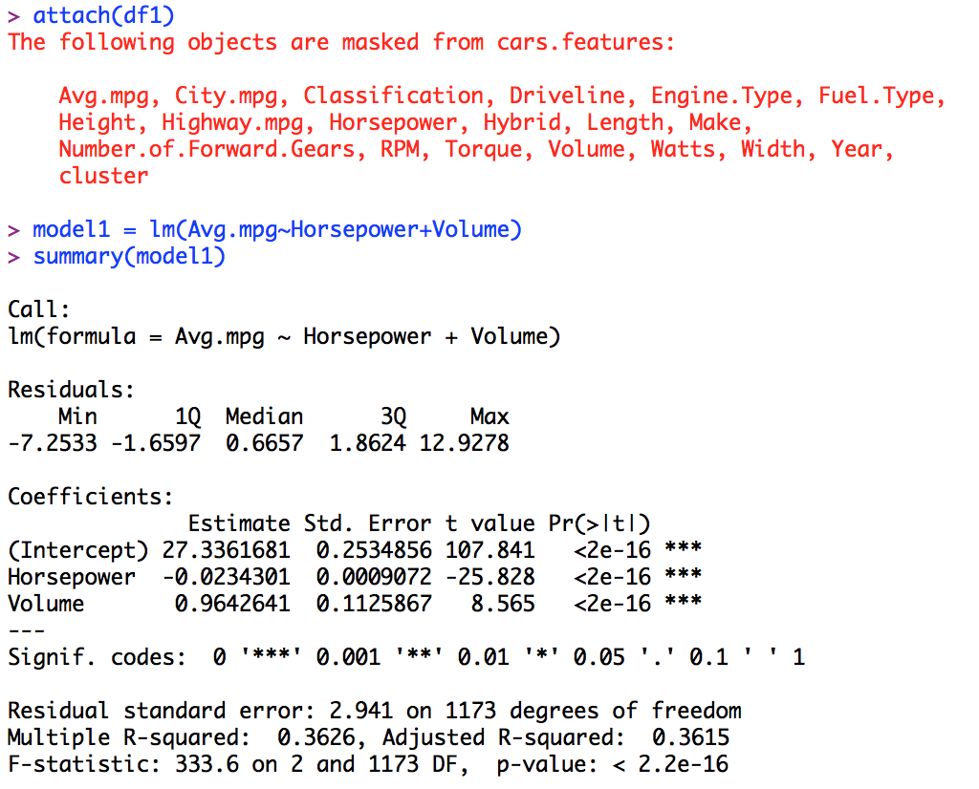
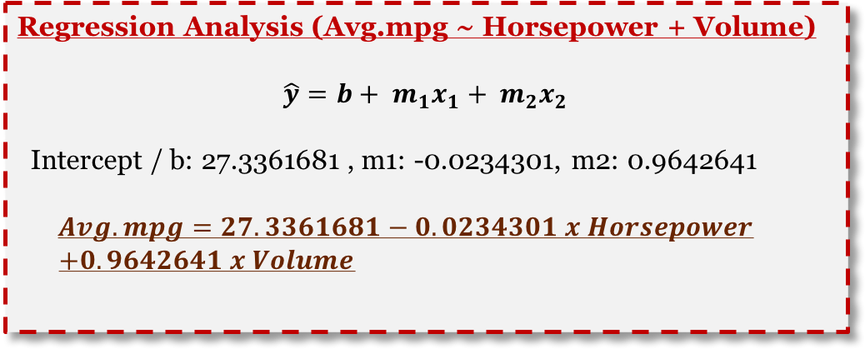
Linear regression analysis (1/4)
Coding involved
Observations
Attaching dataframe 1 (df1) which only contains observations with cluster variable value of 1 with attach() function
Running linear regression analysis by setting the dependent variable to be Avg.mpg and independent variables Horsepower and Volume, respectively
Regression Analysis (Avg.mpg ~ Horsepower + Volume)
$$\hat{y}=b+ m_{1}x_{1}+ m_{2}x_{2}$$
Intercept / b: 27.3361681 , m1: -0.0234301, m2: 0.9642641
$$Avg.mpg=27.3361681−0.0234301 x Horsepower$$
$+0.9642641 x Volume$

Slide 22
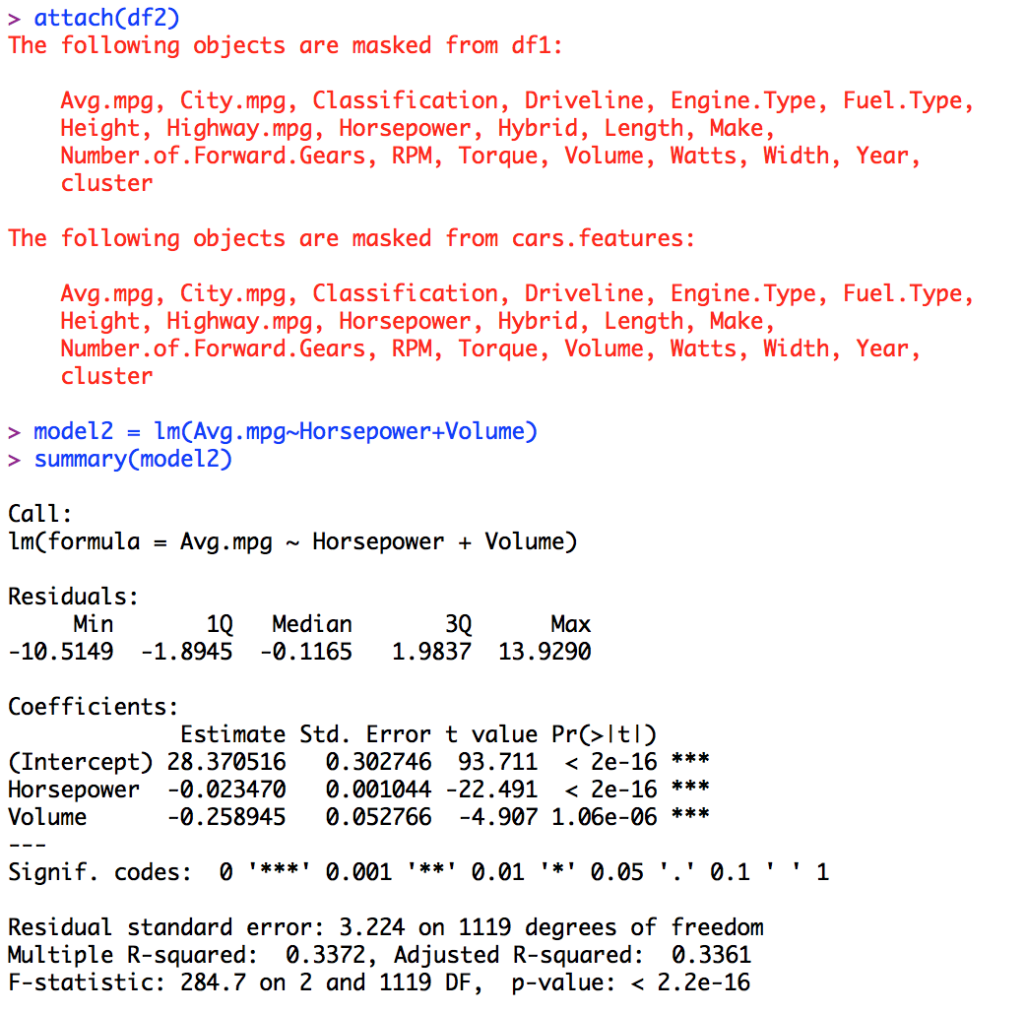
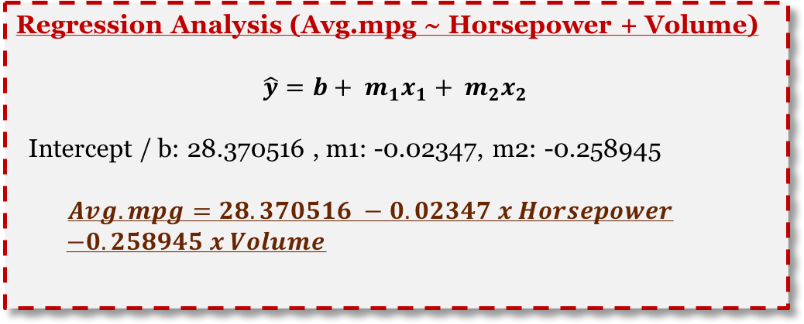
Linear regression analysis (2/4)
Coding involved
Observations
Attaching dataframe 2 (df2) which only contains observations with cluster variable value of 2 with attach() function
Running linear regression analysis by setting the dependent variable to be Avg.mpg and independent variables Horsepower and Volume, respectively
Regression Analysis (Avg.mpg ~ Horsepower + Volume)
$$\hat{y}=b+ m_{1}x_{1}+ m_{2}x_{2}$$
Intercept / b: 28.370516 , m1: -0.02347, m2: -0.258945
$$Avg.mpg=28.370516 −0.02347 x Horsepower$$
$−0.258945 x Volume$

Slide 23
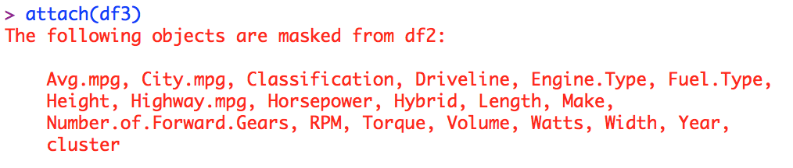
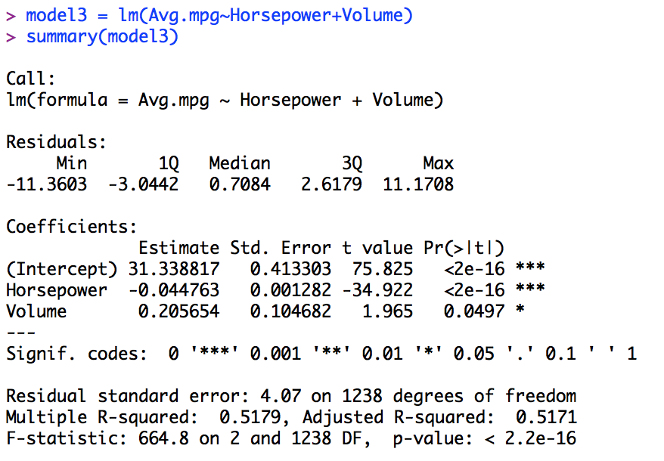
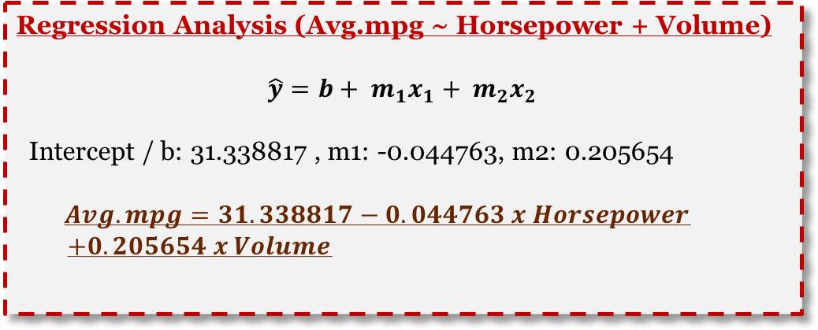
Linear regression analysis (3/4)
Coding involved
Observations
Attaching dataframe 3 (df3) which only contains observations with cluster variable value of 3 with attach() function
Running linear regression analysis by setting the dependent variable to be Avg.mpg and independent variables Horsepower and Volume, respectively
Regression Analysis (Avg.mpg ~ Horsepower + Volume)
$$\hat{y}=b+ m_{1}x_{1}+ m_{2}x_{2}$$
Intercept / b: 31.338817 , m1: -0.044763, m2: 0.205654
$$Avg.mpg=31.338817−0.044763 x Horsepower$$
$+0.205654 x Volume$

Slide 24

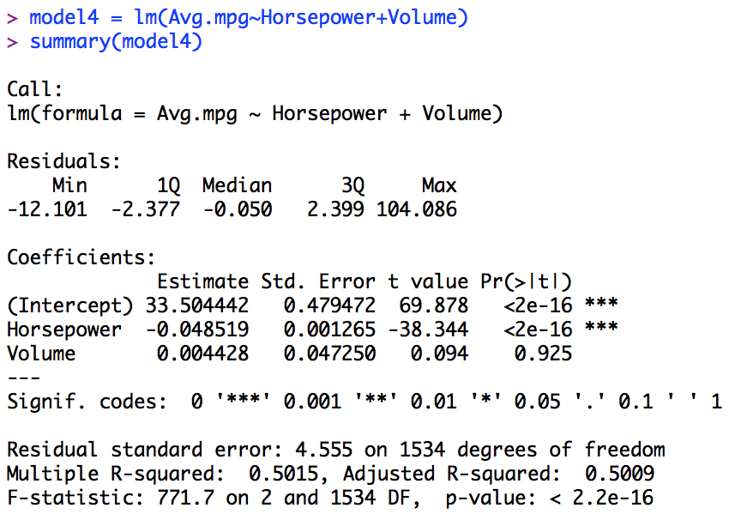
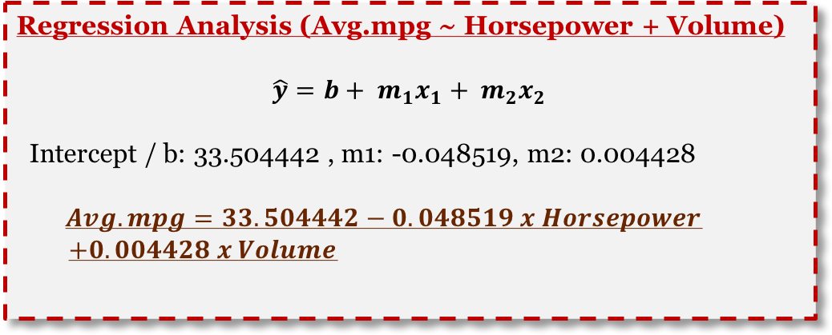
Linear regression analysis (4/4)
Coding involved
Observations
Attaching dataframe 4 (df4) which only contains observations with cluster variable value of 4 with attach() function
Running linear regression analysis by setting the dependent variable to be Avg.mpg and independent variables Horsepower and Volume, respectively
Regression Analysis (Avg.mpg ~ Horsepower + Volume)
$$\hat{y}=b+ m_{1}x_{1}+ m_{2}x_{2}$$
Intercept / b: 33.504442 , m1: -0.048519, m2: 0.004428
$$Avg.mpg=33.504442−0.048519 x Horsepower$$
$+0.004428 x Volume$

Slide 25
Statistical Significance and regression equation (compiled)
Regression equation
Avg.mpg = 27.34 - 0.023(Horsepower) + 0.964(Volume)
Statistical Significance
All of the significance value from df1 are <2e-16 ***, which means all of the variable are significance
Key takeaways
The regression equation from the data frame 2 differs from the others, due to the constant for the variable Volume is negative, while for the others are positive
In data frame 1, the constant for the variable volume is the least impactful, with the value of 0.964 which considerably close to ~1
By looking at the statistical significance value, all of the independent variable on data frame 1 and 2 are all significant, due to the value is approximately close to ~0
Meanwhile, on data frame 4, the statistical significance for the variable Volume is not significant, 0.925
In addition, on data frame 3, the statistical significance for the variable Volume is less significant compares to df 1 and 2, with the significance codes and value of 0.0497 *
df1
Regression equation
Avg.mpg = 28.37 - 0.023(Horsepower) - 0.258(Volume)
Statistical Significance
The significance value for Horsepower and Volume are <2e-16 *** and 1.06e-06 ***, respectively
df2
Regression equation
Avg.mpg = 31.34 - 0.045(Horsepower) + 0.206(Volume)
Statistical Significance
In df3, the variable Volume is less significance, with the value of 0.0497 *
df3
Regression equation
Avg.mpg = 33.5 - 0.0485(Horsepower) + 0.004(Volume)
Statistical Significance
In df4, the variable Volume is not significance at all, with the value of 0.925
df4

Slide 26
9|
Insights and Conclusions

Slide 27
Insights and conclusions
By fully utilizing R in data analysis, some messy datasets that requires to be cleaned can be done in ease through some data manipulation techniques
With the assistance of clustering, the given data visualization charts and graphs determined some key observations and provides easy observation through interactive color and grouping
We can create and determine new dependent (Avg.mpg) or independent variables (RPM, Volume, Watts) in R based on the formulas
In regression analysis on each data frame, even though they are from the same dataset, the statistical significance and the regression equation may differs
By applying cluster analysis, observing patterns and trends on the 4 data visualization attached helps us to draw conclusions even faster

